Slide 1


BeePathNet
„About the project!“
City Visit - Bydgoszcz
18th – 19th June 2018
Maruška Markovčič and Klemen Strmšnik

Slide 2
BeePathNet – how did it start?
BeePathNet project is all about URBAN BEE-KEEPING!
The City of Ljubljana successfully developed a BEE PATH project…
… which grew into a BEE PATH concept…
… which evolved into:
a PHYSICAL PATH
a NETWORK
an EDUCATIONAL PROGRAMME
a THINK-TANK & an INCUBATOR
a MOVEMENT

Slide 3
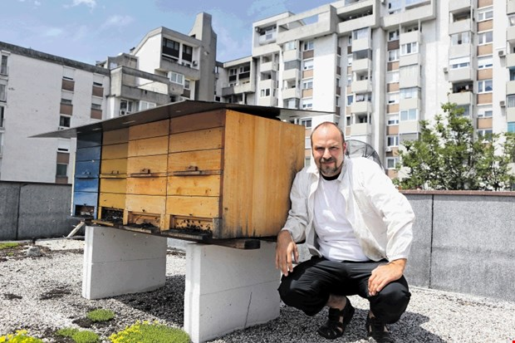
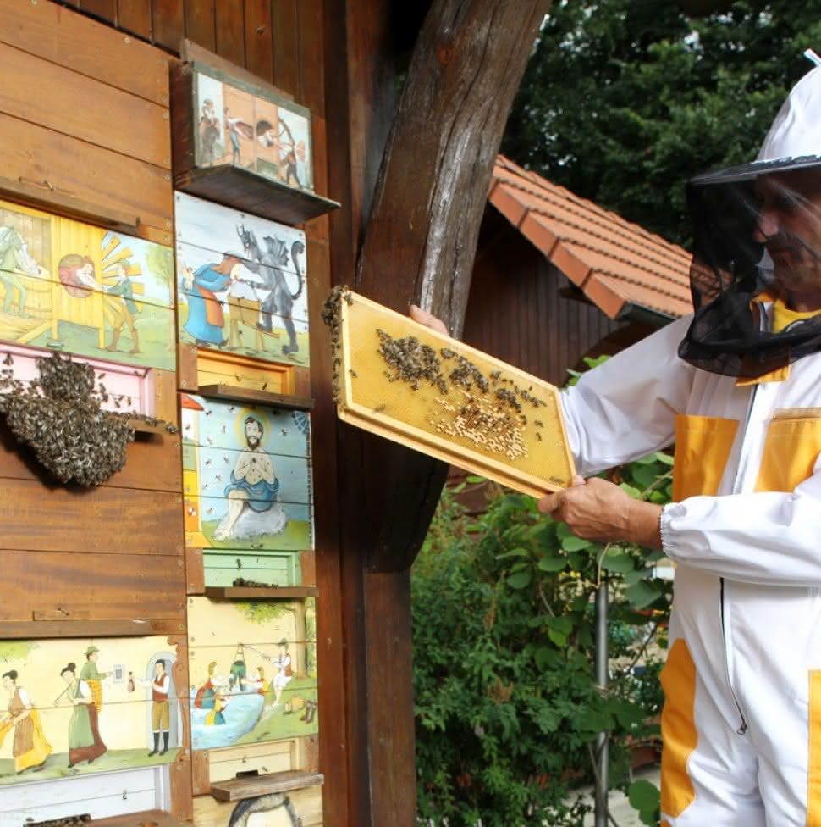
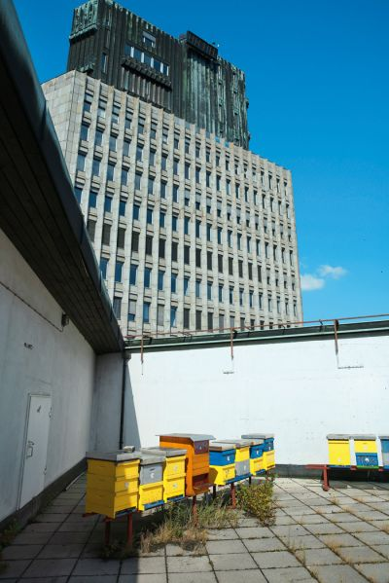
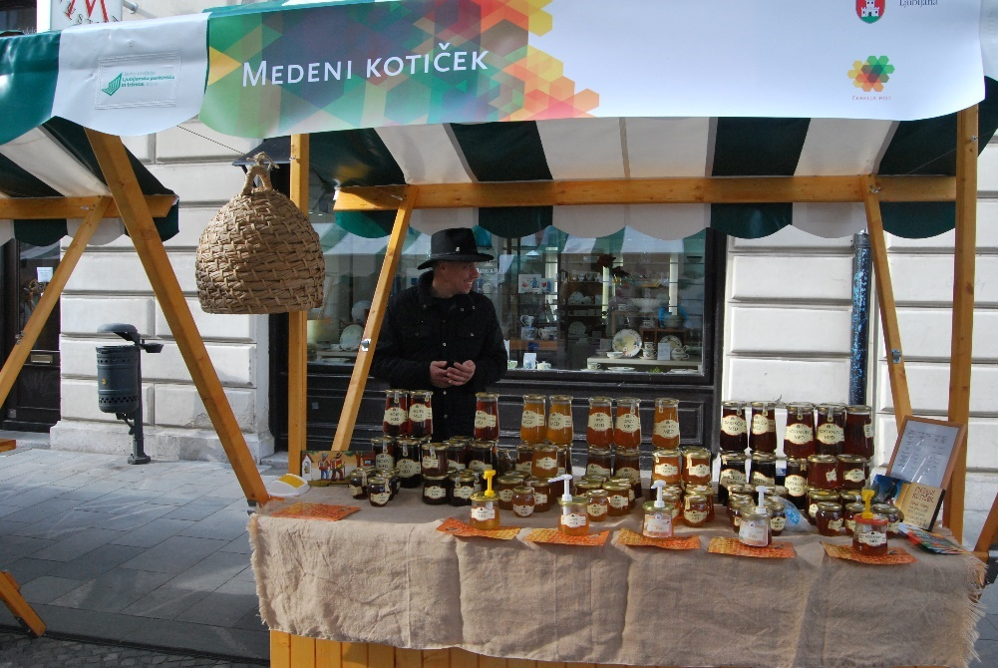
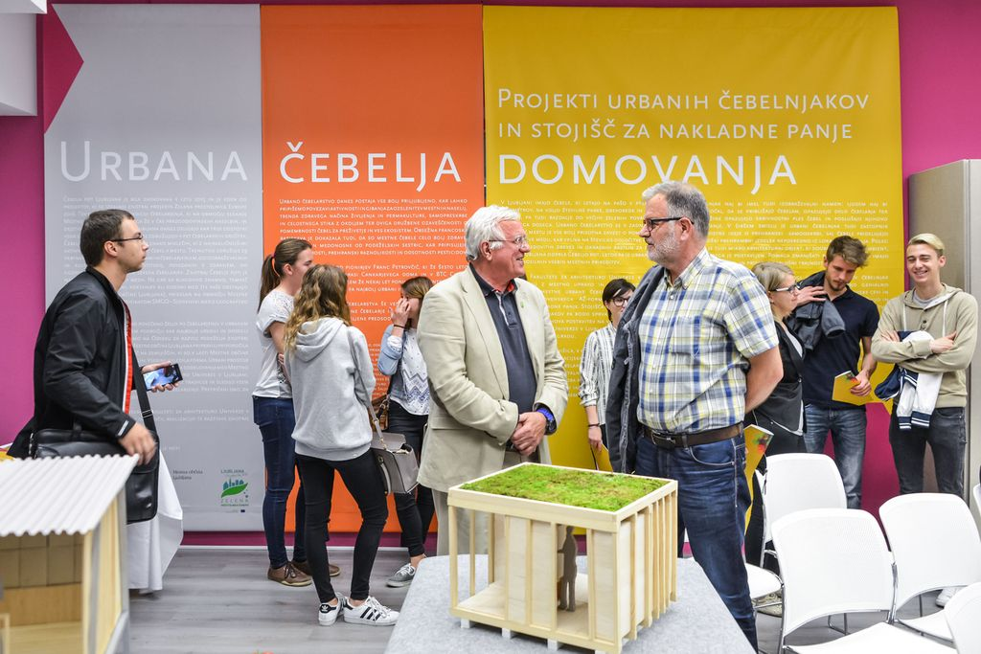
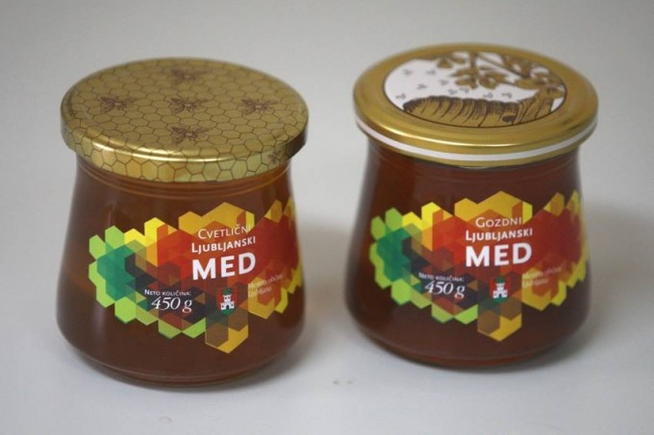

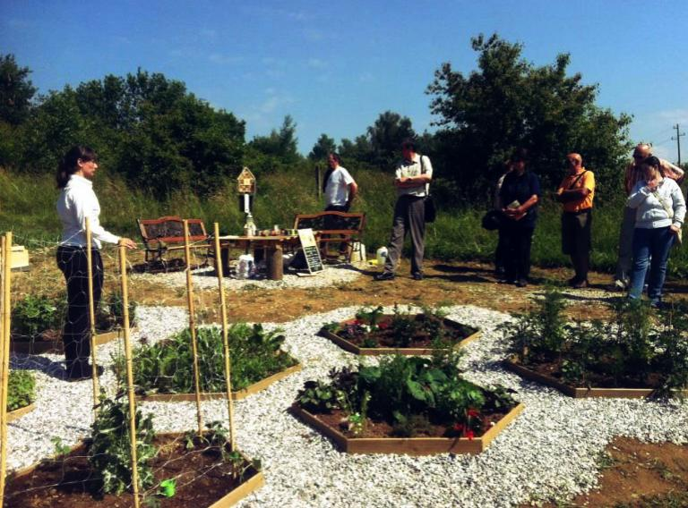
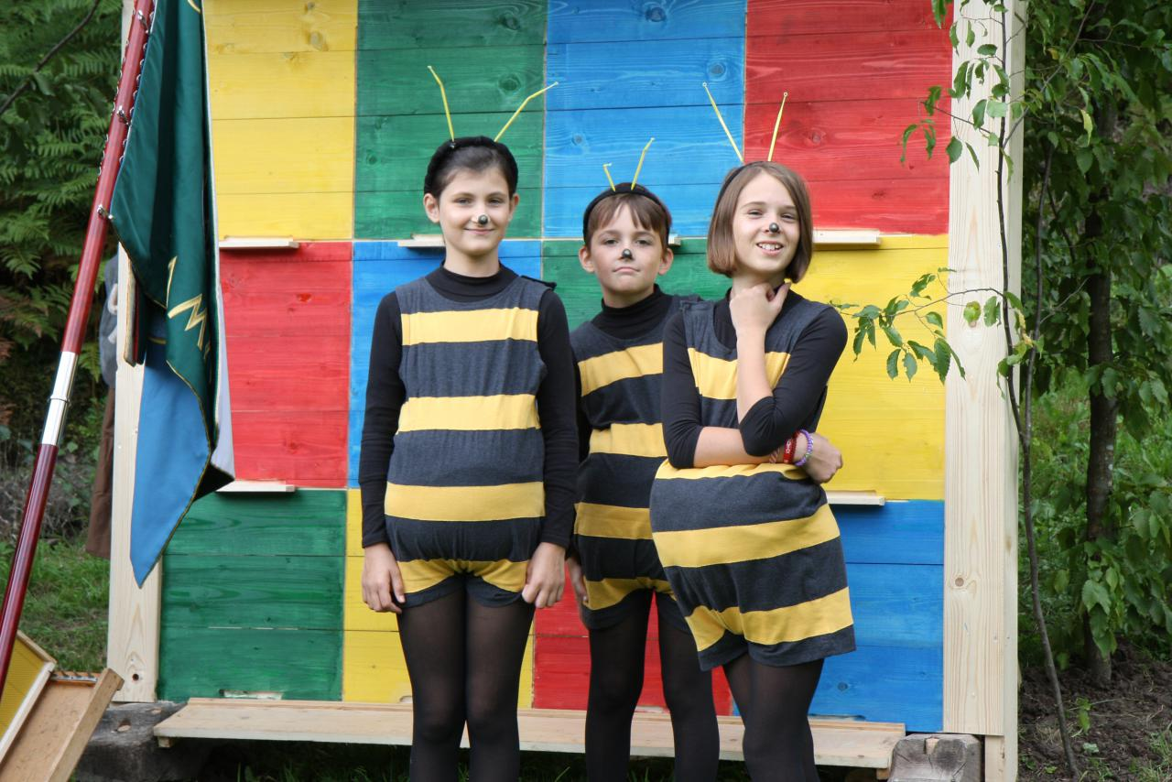
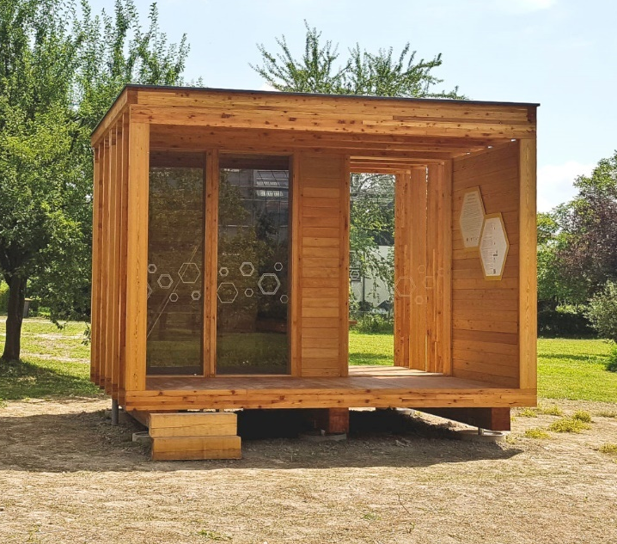
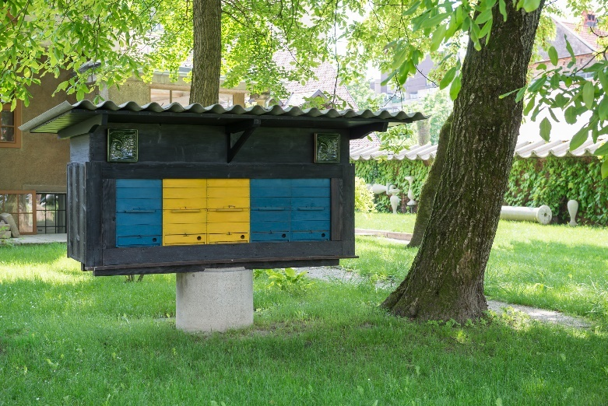

Slide 4
BeePathNet – how did it start?
BEE PATH project was in 2017 named „a Good Practice“ by URBACT.
The City of Ljubljana was encouraged to start sharing it‘s Good Practice with other EU Cities.
BeePathNet partnership was formed with Cesena (ITA), Bydgoszcz (POL), 12th District of Budapest (HUN), Amarante (POR), Nea Propontida (GRE).
BeePathNet project was developed and approved by URBACT Programme.

Slide 5
BeePathNet – what do we want to acheive?
To promote importance of bees for biodiversity and food-security.
To spark the enthusiasm in all of you about urban bee-keeping.
To form an international network of bee friendly cities and citizens.
To transfer most suitable elements of BEE PATH Good Practice to your city.
To raise awarenes and attract key stakeholders and target groups.
To establish urban bee-keeping as an integral component of urban lifestyle.

Slide 6
BeePathNet – what is the City Visit about?
Presenting and explaining the BEE PATH Good Practice
Getting to know all important stakeholders
Understanding bee-keeping situation and potentials in your City
Sharing experience of the City of Ljubljana in urban bee-keeping
Identifying potentials for transfer of BEE PATH Good Practice to your City
Defining next steps in BeePathNet project development

